Slide 1



Code_blooded
Multi-stage Image Restoration & Enhancement
Muhammad Ahmed Naseer
Presented by:

Slide 2
Goal
Restore degraded images like
Blur image
Noisy image
Low lightening image
Low resolution image
Object detection
Image
video

Slide 3
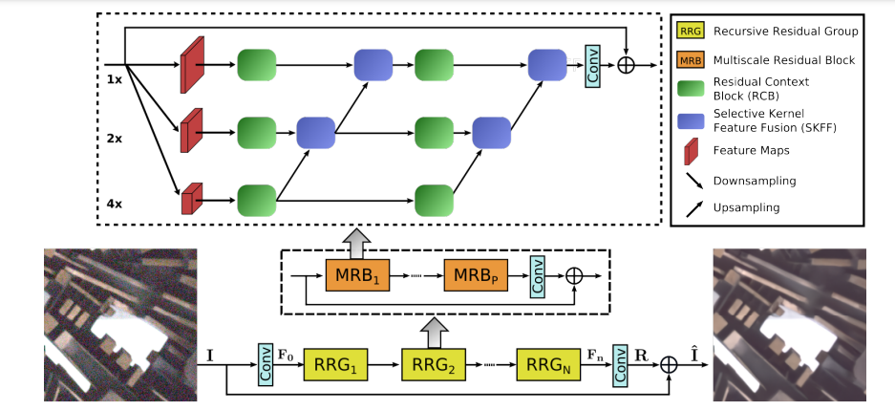
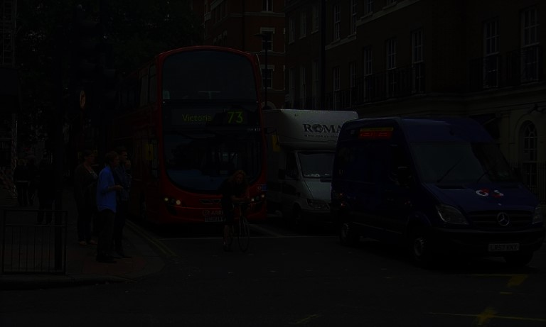
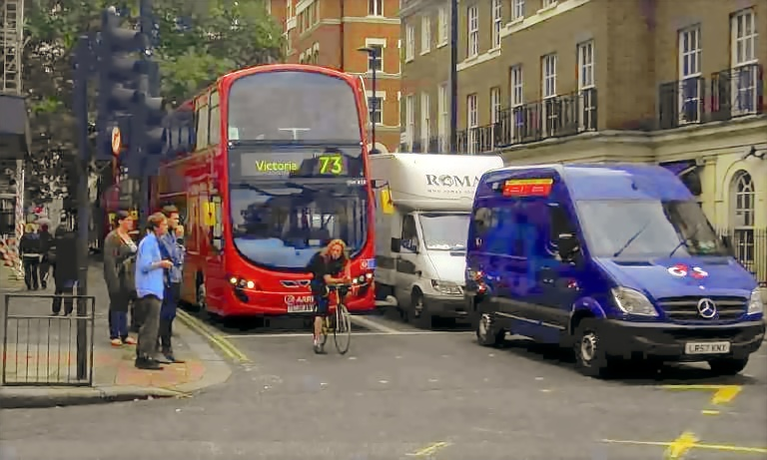

Model working

Slide 4
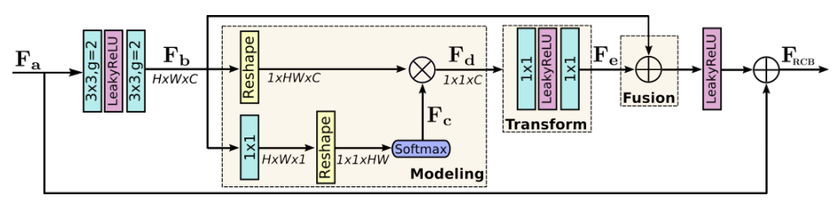

Slide 5
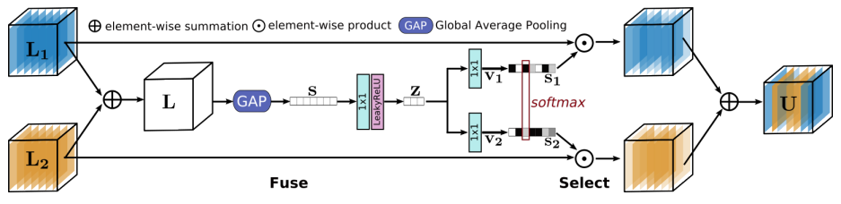

Slide 6
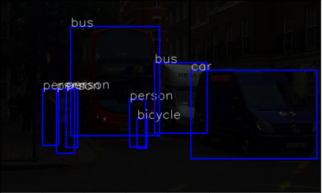
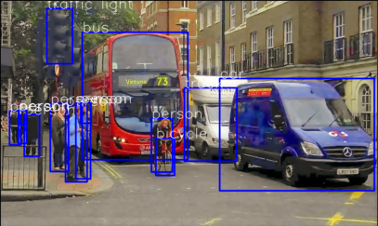
Faster RCNN
Faster RCNN model

Slide 7
Comparison

Slide 8


Code
Go to Colab notebook for code

Slide 9
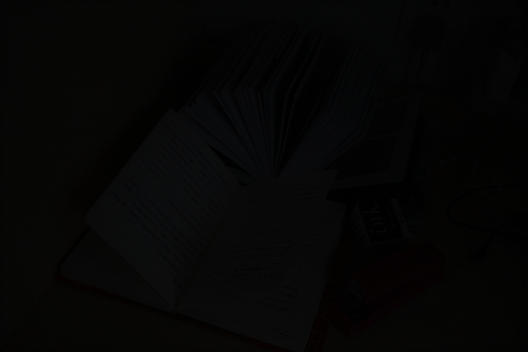
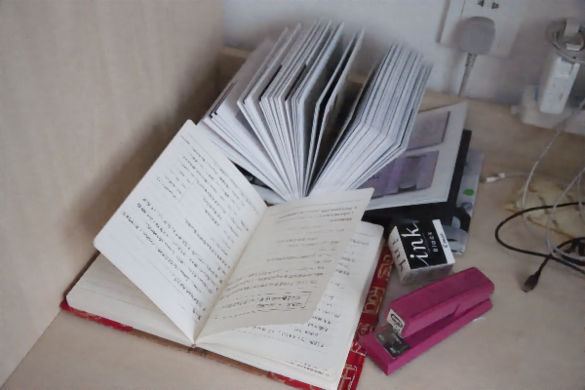
Low-Enhancement

Slide 10
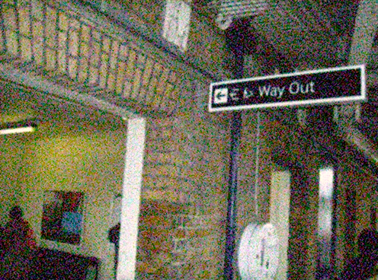
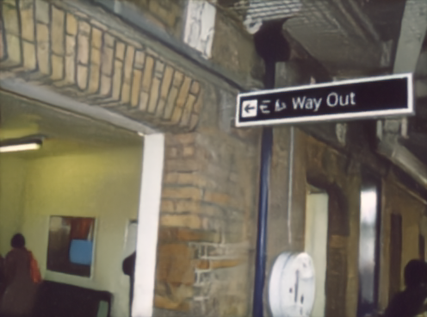
Denoising

Slide 11
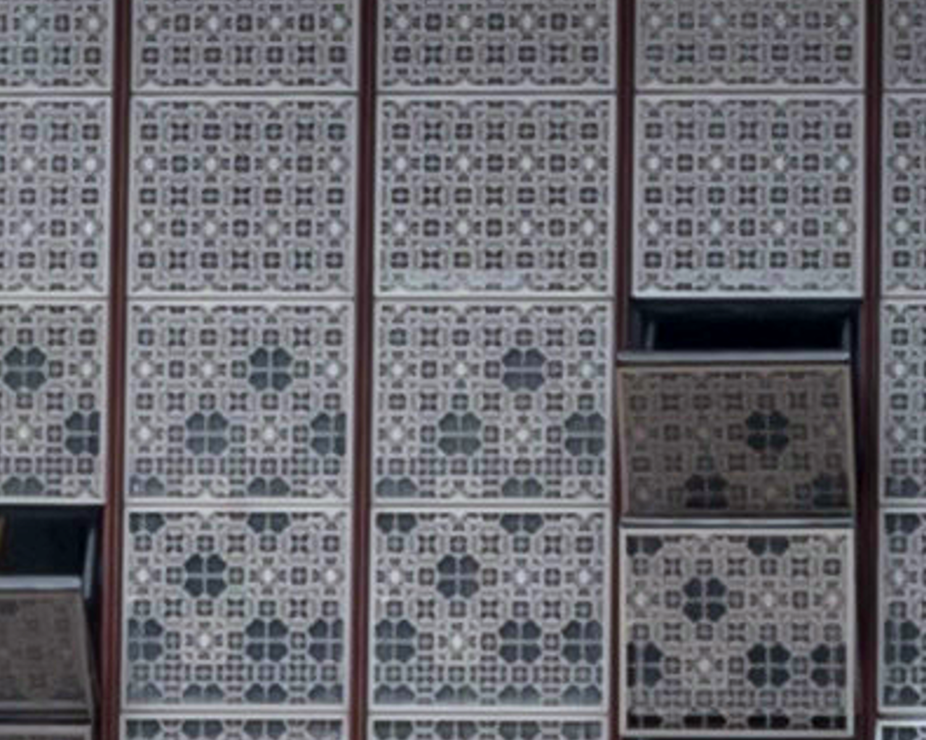
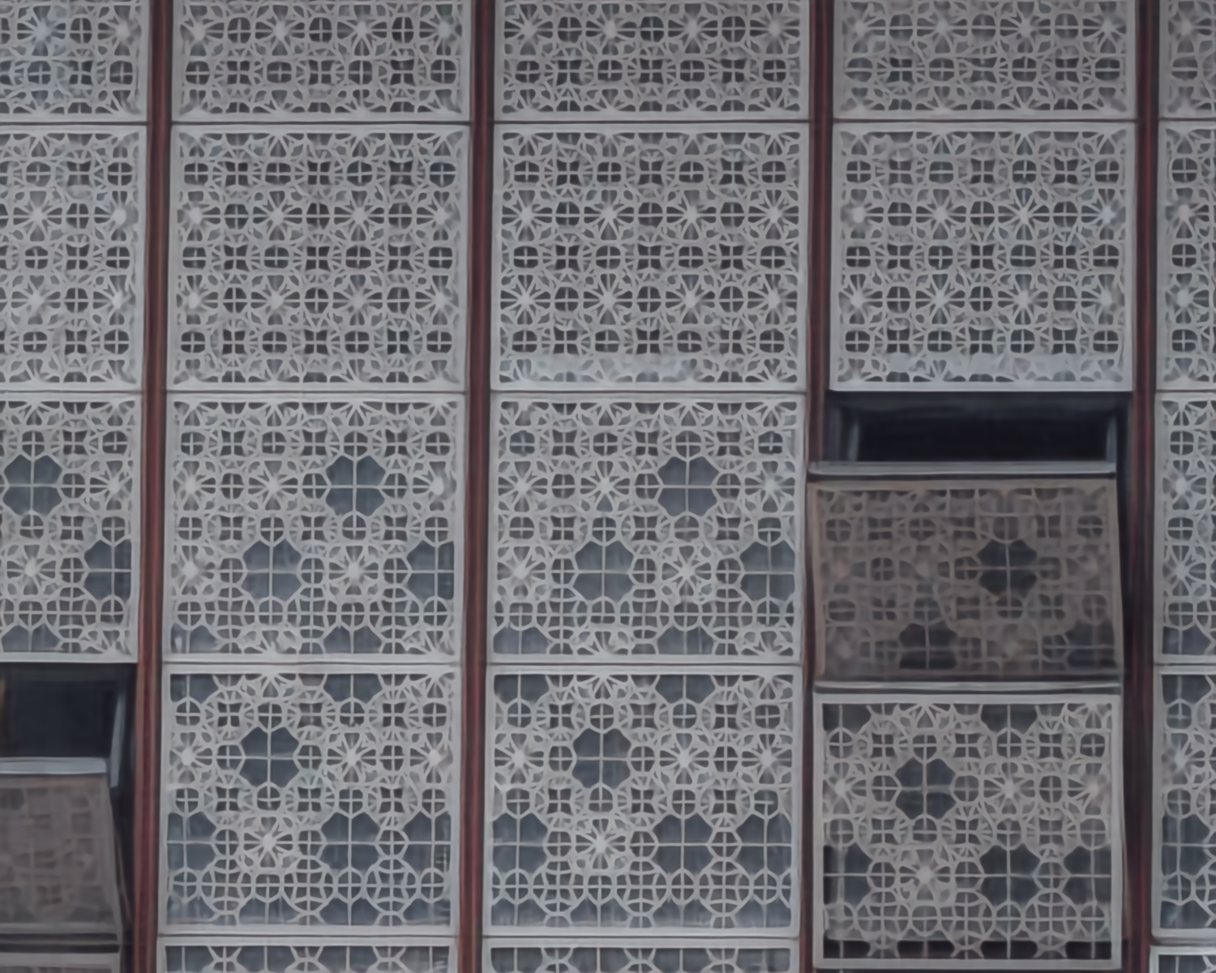
Super-Resolution

Slide 12





STUDIO SHODWE
Hectic to run each cell one by one
+123-456-7890
hello@reallygreatsite.com
www.reallygreatsite.com
123 Anywhere ST., Any City, ST 12345

Slide 13
Any solution ?

Slide 14

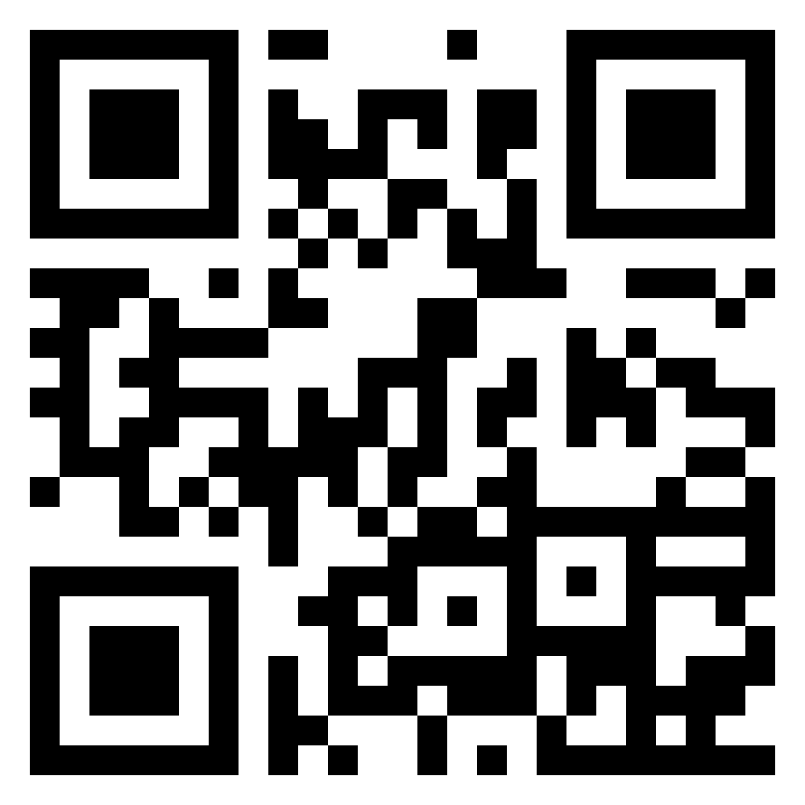
Scan me

Slide 15
